Slide 1

Depth Session #1
Topics: Dynamic Programming - I Kadane Variants

Slide 2
Original Kadane Problem
Given an array A[] of N numbers, find maximum sum subarray?
Example A[] = 0 1 2 3 4 5
3 | -7 | 4 | 2 | -1 | 4
4 + 2 -1 + 4 = 9

Slide 3
Original Kadane Problem
As with all DPs lets start by defining DP formally (A must do!)
Let DP[i] = Maximum Sum subarray ending at i position amongst all subarrays that can be formed in range [1, i] ending at position i
Now lets assume we have computed answer for all j such that j < i.

Slide 4
Original Kadane Problem
Clearly, the maximum sum subarray ending at ith position can be found be either
Extending Maximum sum subarray ending at position at ith = DP[i-1] (Recall how we defined DP) OR
Start a new window at ith position, since previous best was negative, it will only lower value we can obtain = A[i]
Since there is no other case than either of these two, we get recurrence
DP[i] = max{DP[i-1] + A[i], A[i]}

Slide 5
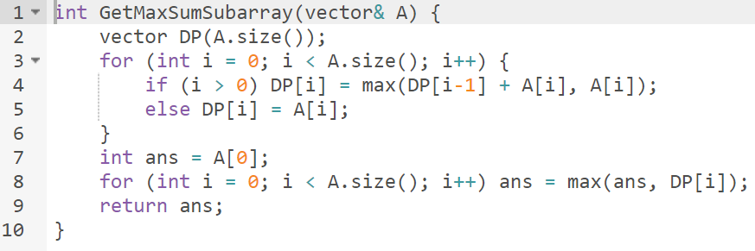
Original Kadane Problem
Question….. Is this good for Interview?

Slide 6
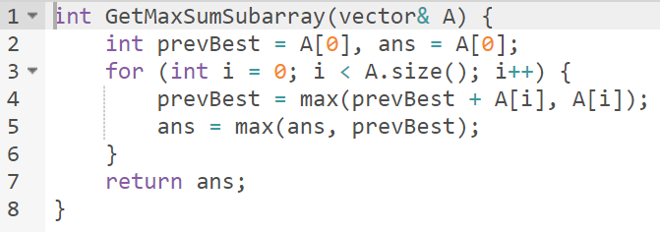
Original Kadane Problem
Time to start giving Space Complexity, active focus for interviews
Time Complexity | O(N)
Space Complexity | O(1)

Slide 7
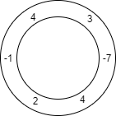
Twist - Circular Kadane
Assume N nodes placed in a circular fashion. ith node has an integer A[i] on it. Find a Contiguous selection of nodes with maximum sum.
Example

Slide 8
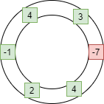
Twist - Circular Kadane
Assume N nodes placed in a circular fashion. ith node has an integer A[i] on it. Find a Contiguous selection of nodes with maximum sum.
Example Max Sum = 12

Slide 9
Twist - Circular Kadane
Time Complexity | O(N)
Space Complexity | O(N)
Example A[] = 0 1 2 3 4 5 6 7 8 9 10 11 Constraint - maximum length considered is N.
Solution #1: Doubling Array Trick
3 | -7 | 4 | 2 | -1 | 4
3 | -7 | 4 | 2 | -1 | 4

Slide 10
Twist - Circular Kadane
Time Complexity | O(N)
Space Complexity | O(1)
A[] = 0 1 2 3 4 5
Solution #2: Invert Sum Trick
Maximizing Selected
A[] = 0 1 2 3 4 5
Is same as Minimizing Invert Selection

Slide 11
Double Slice Kadane
Given an Array A[] of N integers. You need to find maximum F(x, y, z) for any x,y,z in range 0 ≤ x < y < z < N. F(x, y, z) is defined as :-
F(x, y, z) = A[x+1]+A[x+2]+A[x+3]+...+A[y-1] + A[y+1]+A[y+2]+A[y+3]+...+A[z-1]

Slide 12
Double Slice Kadane
If problem looks difficult, either it is.. Or its simple ( : >> Observation #1: F(x, y, z) is same as sum of range [x, z] - A[y]
>> Smells Original Kadane with 1 deletion allowed! Lets call it 1-hole Kadane. >> Observation #2: For every selection of position y, we correspondingly get a fixed position x and z! This hints us scope of improvement and that we can probably think only in terms of choosing valid positions for y.

Slide 13
1-Hole Kadane
Given an Array A[] of N integers. Select all possible subarrays, you are allowed to drop one integer from that subarray. Find maximum sum of all such subarray and drop selections. Solution 1 : Left-Right / Right-Left precompute
Building from Observation #2.. Lets define ,
Now for every fixed position of y, we need to see maximum value for DP_LeftToRight[y-1]+DP_RightToLeft[y+1] and we are done!
Time Complexity | O(N)
Space Complexity | O(N)
DP_LeftToRight[i] = Max sum subarray that ends at position i.
DP_RightToLeft[i] = Max sum subarray that starts at position i.

Slide 14
1-Hole Kadane
Is that best we can do for the problem?
Can we extend previous solution to O(1) space? Why or why not? Reason out loud.

Slide 15
1-Hole Kadane
Solution #2: State Change Kadane
We can’t extend Solution #1 to O(1) space because of direction. That insight, strongly hints us to Redefine DP State. A general takeaway. Lets redefine our DP.
Let DP[i][0] = Max subarray ending at ith position and has not dropped any integer so far.
Let DP[i][1] = Max subarray ending at ith position after dropping atmost 1 integer
Final answer will be DP[N][1] (Why?).

Slide 16
1-Hole Kadane
Recurrence relations formed :-
DP[i][0] = max(DP[i-1][0] + A[i], A[i])
DP[i][1] = max(DP[i-1][0] + 0, DP[i-1][1] + A[i])
Homework
Work your reasons why it works?
Re-read thought process how we build Solution #2 from Solution #1. [Very Imp]

Slide 17
K-Hole Kadane
Extending previous problem, find maximum sum subarray given you are allowed to drop atmost K contagious integers.
Example A[] = 0 1 2 3 4 5
Optimal answer is to select range [0, 5] and drop range [1,4] which gives us sum of 7.
3 | -7 | -5 | 2 | -1 | 4

Slide 18
K-Hole Kadane
Lets simplify problem again and change Problem perspective. We can see problem as,
This clearly points us to direct solution - Re utilize 1-Hole Kadane Solution.
Find two disjoint subarray whose sum is maximum.

Slide 19
K-Hole Kadane
Solution #1 - Leveraging 1-Hole Kadane
Precompute LeftToRight Kadane and RightToLeft Kadane.
Formally,
DP_LeftToRight[i] = Max sum subarray starting at position i
DP_RightToLeft[i] = Max sum subarray ending at position i
Now choose all possible pairs (i,j) such that i ≤ j and take maximum of DP_LeftToRight[i]+DP_RightToLeft[j]. Thats your answer!
Time Complexity | O(N^2)
Space Complexity | O(N)

Slide 20
K-Hole Kadane
Solution #2 - Redefining 1-Hole Kadane DP state
All we need to improve from O(N^2) solution to O(N) solution is to redefine our DP!
Lets Redefine,
DP_LeftToRight[i] = Max sum subarray that lies in range [0, i]
DP_RightToLeft[i] = Max sum subarray that lies in range [i+1, N]
Now notice, because of how we defined our DP, we don't need to have two loops for every possible pair of (i,j) like in previous problem.
Answer is simply, max amongst DP_LeftToRight[i]+DP_RightToLeft[i] for all valid i.
Time Complexity | O(N)
Space Complexity | O(N)

Slide 21
Max Sum Subset with no two adjacent selection
Solution #2 - Redefining 1-Hole Kadane DP state
All we need to improve from O(N^2) solution to O(N) solution is to redefine our DP!
Lets Redefine,
DP_LeftToRight[i] = Max sum subarray that lies in range [0, i]
DP_RightToLeft[i] = Max sum subarray that lies in range [i+1, N]
Now notice, because of how we defined our DP, we don't need to have two loops for every possible pair of (i,j) like in previous problem.
Answer is simply, max amongst DP_LeftToRight[i]+DP_RightToLeft[i] for all valid i.
Time Complexity | O(N)
Space Complexity | O(N)

Slide 22
Non-contagious Kadane
Given an array of integers, find a subset with maximum possible sum, such that no two selected integers in subset are adjacent.
Example A[] = 0 1 2 3 4 5
3 | 10 | 4 | -2 | -1 | 4

Slide 23
Non-contagious Kadane
Given an array of integers, find a subset with maximum possible sum, such that no two selected integers in subset are adjacent.
Example A[] = 0 1 2 3 4 5 Its optimal to choose 10 and 4, which gives a sum of 14.
3 | 10 | 4 | -2 | -1 | 4

Slide 24
Non-contagious Kadane
Even though, we aren't talking about 'Contagious' arrays here, we are still talking about essence of Kadane :)
Lets define,
DP[i] = Max sum subset in between [0,i]
Recurrence relation for DP
DP[i] = max(DP[i-2] + A[i], DP[i-1])
Logic behind the DP is, either you select ith element and hence cannot pick previous element, or simply continue after selecting (i-1)th element.

Slide 25
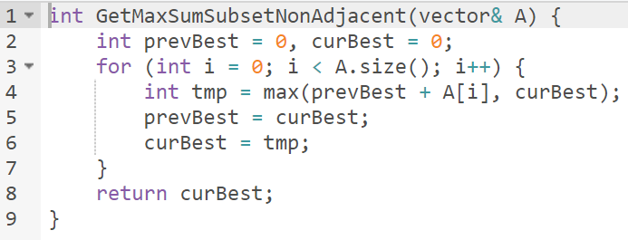
Non-contagious Kadane
This question, Kadane and number of binary string.. All have essentially same idea!

Slide 26
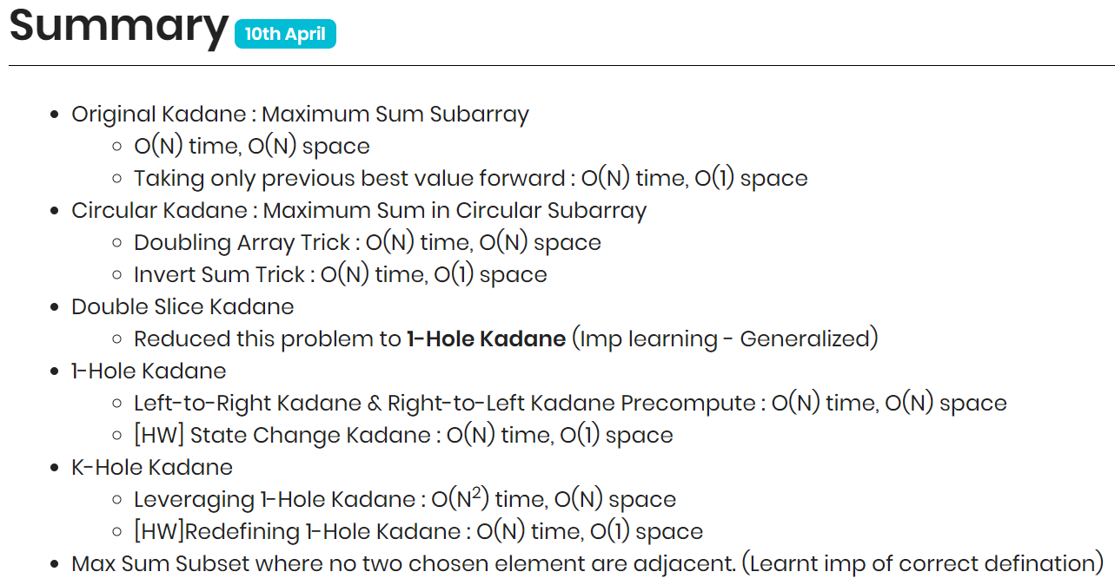

Slide 27
Learnings?
Learnings?
Always Define DP formally! Its helpful to build solutions.
Start thinking about Space complexity for everything you solve. Easiest brownie points you can score.
Super powerful trick - Changing DP state (1) to optimize space (2) to come up with working solution
Problem Simplification and Changing perspective to problem is underrated!
Keep connecting whatever you study! Improves your pattern recognition 2x

Slide 28

Learnings?
Start from identifying where exactly are you stuck.. Reason or stem your next step from there.. Its your signboard!

